Slide 1
Monday, August 14, 2017
Write In Your Agenda:
Write In Your Monitoring Log:
CW:
Conduct monster peer assessments
Metric Word Search and Scramble
HW:
Take Metric Monster Home
Metric Word Search and Scramble (if not finished)
Response to Warm-Up:
Are you proud of or disappointed in your metric monster? Explain.
You will need:
Pencil
Agenda
New Monitoring Log
Hand in old Monitoring Log
Metric Monster

Slide 2
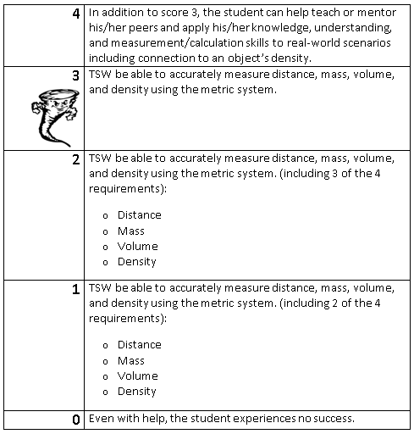
Learning Goal and Scale
TSW be able to accurately measure distance, mass, volume, and density using the metric system.

